Slide 1
Project Management

Slide 2
Project Management:
Project Management is one of the most important support disciplines of the unified process (UP).
We look first at Project Management in a broader context as a requirement for the managing all types of project.
The development of a new software system :- the improvement or upgrade of an existing system, or even the integration & deployment of a software package into an existing environment are all brought about during a development project.
A project is a planned undertaking with beginning and end that produces a predetermined result or product and usually constrained by a schedule & resources.

Slide 3
A project have specific objective,
Different products are produced, different activities are required for varying schedules, and difference resources are produced.
Project management support to make a good project that is project success factors.
There are some reasons that project do not fulfill desired objectives vary, only partially successful as;
  incomplete or changing system requirements.
  limited user involvement
  lack of executive support
  poor project planning
  unclear objective
  Lack of required resources.

Slide 4
There are some reasons of factors to make a successful project. They are:
  clear system requirement definitions
  substantial user involvement
  support from upper management.
  details project plan
  restrict work schedules and milestones.
  To make successful project, project management is organizing & directing other people to achieve a planned result within a predetermined scheduled and budget.

Slide 5
There are nine different knowledge areas in Project management, provide an excellent foundation.
  Project Scope Management: defining and controlling the functions that are to be included in the system as well as the scope of the work to be done by the project team.
  Project Time Management: building a detailed schedule of all project tasks and then monitoring the progress of the project against defined milestones.
  Project Cost Management: calculating the initial cost/benefit analysis and its later updates and monitoring expenditures as the project progress.
  Project Quality Management: Establishing a total plan for ensuring quality, which includes quality control activities for every phase of the project.

Slide 6
  Project Human Resources Management: Recruiting and hiring project team members; training, motivating, and team building; and implementing related activities to ensure a happy, productive team.
  Project Communications Management: Identifying all stakeholders and the key communications to each; also establishing all communications mechanisms & schedules.
  Project Risk Management: Identifying and reviewing throughout the project all potential risks for failure and developing plans to reduce these risks.
  Project Procurement Management: Developing request for proposals, evaluating bids, writing contracts, and then monitoring vendor performance.
  Project Integration Management: Integrating all the other knowledge areas into one seamless whole.

Slide 7
  So, Project Management is also an integral part of the unified process.
  One of the support business disciplines defined for the UP is project Management.

Slide 8
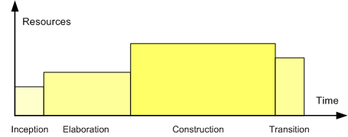
THE UNIFIED PROCESS AND THEIR PHASES (Project Life Cycle)
The Unified Process divides the project into four phases:
  Inception
  Elaboration
  Construction
  Transition
Profile of a typical project showing the relative sizes of the four phases

Slide 9
1. Inception Phase
Inception is the smallest phase in the project, and ideally it should be quite short.
If the Inception Phase is long then it is usually an indication of excessive up-front specification, which is contrary (opposite) to the spirit of the Unified Process.
The following are typical goals for the Inception phase.
    Establish a justification for the project
    Establish the project scope and boundary conditions
    Outline the use cases and key requirements that will drive the design tradeoffs
    Outline one or more candidate architectures
    Identify risks
    Prepare a preliminary project schedule and cost estimate

Slide 10
In the inception phase of the UP has the following objectives:
  Identify the business need for the project.
  Establish the vision for the solution
  Identify the scope of the new system and the project.
  Develop preliminary schedules and cost estimates
  Develop the business case for the project.

Slide 11
The end result of this phase is to have a set of documents that establish the vision, scope, business case, schedule, and direction for the rest of the project.

Slide 12
Another most important part of the inception phase is Business modeling.
So, the primary purpose of the business modeling disciplines is to ensure that the system developers thoroughly understand the needs of the business and that the solution system will, in fact, address the correct issues of the business.
Business modeling begins in the inception phase.
During the inception phase, it is most important that a clear vision of the new system and the overall scope be defined.

Slide 13
The following activities are business modeling activities used routinely during inception.
  Understand the business environment
    Describe the problem or need.
    Consider the need interfaces to other system.
    Evaluate existing architecture & system constraints or standards.
    Analyze the various system stakeholders.
  Create the system vision
    Generate a list of primary business benefits.
    Create a list of system objectives.
    Develop a list of system capabilities.
  Create business models
    Identify business events
    Model business processes and workflows.
    Define information and data flow models

Slide 14
Creating the System Vision
The purpose of creating a system vision is to ensure that is clear understanding of how a development project and the new system contribute to the strategic direction of the organization.
One of the key success factors of system projects is that there be a clear vision.
Everyone needs to understand why the project has been initiated and what contribution it is expected to make to the organization.
But vision must be communicated to the team and to other stakeholders.

Slide 15
So, project management is one of the key disciplines of the inception phase.
Activities associated with business modeling and the environment provide much of the detailed information that the development team uses to finalize the project’s scope and plans.
So, during inception phase, the initiating and planning processes are the primary focus.
The following list identifies the main activities involved in initiating and planning the project
  Finalized the system and project scope.
  Develop the project and iteration schedules (develop work breakdown structure, develop the schedule, develop resource requirements & staffing plan).
  Identify project risk and confirm project feasibility. (access the risk to the project, evaluate the technology feasibility, determine the schedule feasibility, access the resource feasibility & determine the economic feasibility-cost benefit analysis).

Slide 16
Project Monitoring and Control
Project monitoring and control being during the inception phase and continuous throughout the project.
Project are monitored and controlled with respect to three areas:
  Manage and control the project plan, including the schedule and deliverables.
  Manage and control internal and external communications.
  Manage and control the risks and outstanding issues.

Slide 17
2. Elaboration Phase
During the Elaboration phase the project team is expected to capture a healthy majority of the system requirements.
However, the primary goals of Elaboration are:
  to address known risk factors and
  to establish and validate the system architecture.
Common processes undertaken in this phase include the creation of use case diagrams, conceptual diagrams (class diagrams with only basic notation) and package diagrams (architectural diagrams).

Slide 18
By the end of the Elaboration phase the system architecture must have stabilized and the executable architecture baseline must demonstrate that the architecture will support the key system functionality and exhibit the right behavior in terms of performance, scalability and cost.
The final Elaboration phase deliverable is a plan (including cost and schedule estimates) for the Construction phase.
At this point the plan should be accurate and credible, since it should be based on the Elaboration phase experience and since significant risk factors should have been addressed during the Elaboration phase.

Slide 19
3. Construction Phase
Construction is the largest phase in the project.
In this phase the remainder of the system is built on the foundation laid in Elaboration.
System features are implemented in a series of short, timeboxed iterations.
Each iteration results in an executable release of the software.
It is customary to write full text use cases during the construction phase and each one becomes the start of a new iteration.
Common UML (Unified Modelling Language) diagrams used during this phase include Activity, Sequence, Colaboration, State (Transition) and Interaction Overview diagrams.

Slide 20
4. Transition Phase
The final project phase is Transition.
In this phase the system is deployed to the target users.
Feedback received from an initial release (or initial releases) may result in further refinements to be incorporated over the course of several Transition phase iterations.
The Transition phase also includes system conversions and user training.

Slide 21
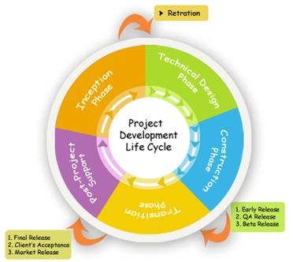

Slide 22
Managing Project Processes

Slide 23
A. Defining and Organizing Projects
A project is an interrelated set of activities that has definite starting and ending points and that results in a unique product or service.
Successful projects begin with a clear definition of scope, objectives, and tasks.
A successful project process begins with
  Clear understanding of its organization
  How people are going to work together to complete the project

Slide 24
1. Select the project manager and project team
a. Project manager—has the responsibility to integrate the efforts of people from various functional areas to achieve specified project goals
b. Project team—a group of people that often represent different functional areas or organizations
2. Define the scope and objectives
a. Scope: the essence of the desired project outcomes in the form of major deliverables (i.e., concrete outcomes of the project process)
b. Time frame: as specific as possible
c. A specific statement of allocated resources in terms of dollars and/or full-time equivalents of personnel time
d. Important to avoid or manage scope creep, the ongoing changes to project scope that may, in sufficient quantity, cause failure

Slide 25
B. Planning Projects: Five Steps
Defining the work breakdown structure
Diagramming the network
Developing the schedule
Analyzing cost-time trade-offs
Assessing risks

Slide 26
1. Define the work breakdown structure (WBS)
a. Identify all work tasks.
b. Generate a hierarchy to the work breakdown: major work components are broken down to smaller tasks or activities.
Activities are the smallest unit or work effort that:
  Consume both time and resources
  Can be controlled and scheduled by the project manager
c. Assign task ownership to team members. Each activity must have an “owner” who is responsible for doing the work.

Slide 27
2. Diagram the network.
Network planning methods can help managers monitor and control projects.
Two network planning methods, developed in the 1950s
  Program Evaluation and Review Technique (PERT)
  Critical Path Method (CPM)
a. Establishing precedence (priority/Preference) relationships
Determine a sequence for undertaking activities
This specifies that one activity cannot start until a preceding activity has been completed

Slide 28
PERT & CPM
A PERT chart is a project management tool used to schedule, organize, and coordinate tasks within a project.
a methodology developed by the U.S. Navy in the 1950s to manage the Polaris submarine missile program.
A similar methodology, the Critical Path Method (CPM) was developed for project management in the private sector at about the same time.
A PERT chart presents a graphic illustration of a project as a network diagram consisting of numbered nodes (either circles or rectangles) representing events, or milestones in the project linked by labeled vectors (directional lines) representing tasks in the project.
The direction of the arrows on the lines indicates the sequence of tasks.

Slide 29
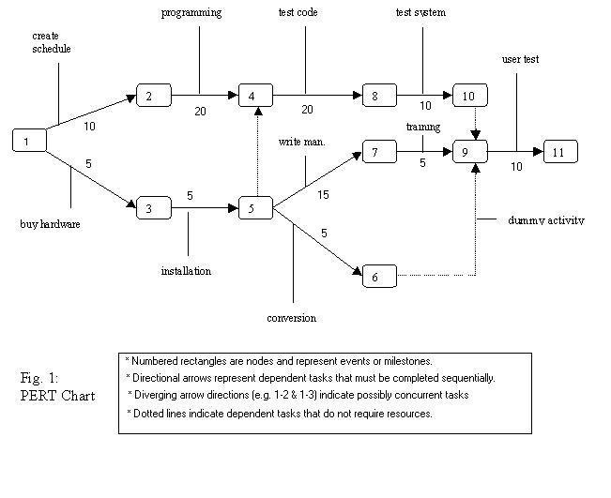
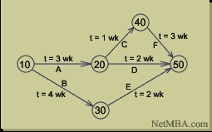
PERT Chart in Network Diagram

Slide 30
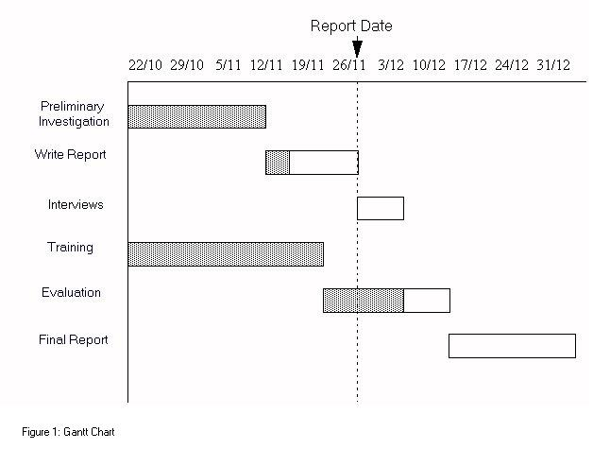
GANTT Chart
definition -
A Gantt chart is a horizontal bar chart developed as a production control tool in 1917 by Henry L. Gantt, an American engineer and social scientist.
Frequently used in project management, a Gantt chart provides a graphical illustration of a schedule that helps to plan, coordinate, and track specific tasks in a project.

Slide 31
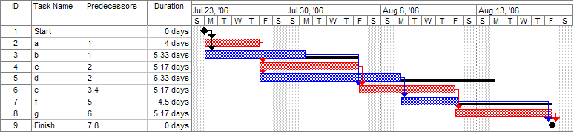
Activity | Predecessor | Time estimates |  |  | Expected time
 |  | Opt. (O) | Normal (M) | Pess. (P)
A | — | 2 | 4 | 6 | 4.00
B | — | 3 | 5 | 9 | 5.33
C | A | 4 | 5 | 7 | 5.17
D | A | 4 | 6 | 10 | 6.33
E | B, C | 4 | 5 | 7 | 5.17
F | D | 3 | 4 | 8 | 4.50
G | E | 3 | 5 | 8 | 5.17
Once this step is complete, one can draw a Gantt chart or a network diagram.

Slide 32
b. A useful approach for creating a network diagram is the activity-on- node (AON) network
  Nodes are activities and arcs, or arrows, show precedence relationships.
  Activity oriented

Slide 33
3. Develop the schedule
a. Estimating activity times
  Statistical methods
  Learning curve models
  Opinion based on similar, prior experience

Slide 34
Project schedule: Gantt charts may be constructed by the project manager. The project activities, with precedence relationships and time durations are superimposes on a time line. The Hospital project Gantt chart may be accessed on the Interactive Website.
e. Activity slack (loose): maximum time an activity can be delayed without delaying the entire project
  Total slack for an activity: a function of the performance of activities leading to it. Total slack = LS – ES or LF – EF.
  Free slack: the amount that an activity’s earliest finish time can be delayed without delaying the earliest start time of an activity immediately following it

Slide 35
4. Analyze cost-time trade-offs
a. Like maintaining project schedules, keeping project costs at acceptable levels is a major goal of project managers.
b. Total project costs are the sum of
    Direct costs (how)
    Indirect costs (how)
    Penalty costs (how)
c. Time-cost trade-offs are almost always a consideration. For example
  Direct costs may be increased by using additional resources to accelerate a project
  Indirect costs may be reduced by reducing total project time.
  Penalty costs may be incurred if a project goes beyond some specified date

Slide 36
The Four Ps: People, Project, Product, and Process in Software Development
The end result of a software project is a product that is shaped by many different types of people as it is developed.
Guiding the efforts of the people involved in the project is a software development process, a template that explains the steps needed to complete the project.
Typically, the process is automated by a tool or set of tools.
So we used different terms for software development which are 4 Ps.

Slide 37
Process
Template
People
Project
Automation
Tools
Participants
Results
Product
The 4 Ps in Software Development

Slide 38
People:
The architects, developers, testers, and their supporting management, plus users, customers, and other stakeholders are the prime movers in a software project.
People are actual human beings, as opposed to the abstract construct of workers.
So, people are crucial involved in the development of a software product throughout its entire life cycle.
They finance the product, schedule it, develop it, manage it, test it, use it and benefit from it.
Therefore, the process that guides this development must be people oriented.
The way in which a software project is organized and managed profoundly affects the people involved in the project.

Slide 39
So, people play important role on following activities for the development of software:
1. Project Feasibility – new or existing or infeasible project.
Risk Management – manage and reduced the insignificant tasks and others assumption.
Team Structure – established a meaningful team to create the working environment to make a effective & productive project.
Project Schedule - prepared effective schedule when project will started and end according to created activities and tasks.
Project Understandability – People like to know what they are doing; they want to understand the whole picture.

Slide 40
Role will change means the key activities of software development are executed by people, there is a need for a uniform development process that is supported by tools and a UML to enable people to be more effective.

Slide 41
Project:
The organizational element through which software development is managed. The outcome of a project is a released product.
A development project results in a new release of a product.
Projects make the Product.
Product:
Artifacts that are created during the life of the project, such as models, source code, executables, and documentation.
Here the term product refers not just to the code that is delivered but to the whole system.

Slide 42
  System Software
  Artifacts
  Collection of models (Unified Process is the model) used to building the software (system).
    Every workers needs a unique perspective of the system
    Unified Process provides a carefully selected set of models with which to start.
Workers participating in software development (some are singleton workers; others are multi-types and multi-objects.)
Users
System
Testers
Architect
Designers
The Project Manager
Use Case Model
Analysis Model
Design Model
Deployment Model
Implementation Model
Test Model
Analysis
The Primary Model Set of the Unified Process

Slide 43
  Each model is self-contained view of the system.
  Inside a model contains subsystem, interface and classes.
  Relationship between model.
Process:
A software engineering process is a definition of the complete set of activities needed to transform users’ requirements into a product.
So, a process is a template for creating projects.
Process is used in many different context, such as business process, development process, and software process, with many different meanings.
In the Unified Process, process refers to a concept that works as a template that can be reused by creating instances of it.
So, Process instance is a synonym for Project.

Slide 44
A process is definition of a set of activities, not their execution.
Finally, a process covers not just the first development cycle (first release) but the most common later cycles.
The main factors that influence how the process will differ are:
  Organizational factors – organizational structures, culture, project organization and management, competence and skill available, previous experience, and existing software system.
  Domain factors – Application domain, business process to support, user community, and offerings available from competitors.
  Life cycle factors – time to market, expected life of the software.\, the technology and the people expertise in developing the software, and planned future release.
  Technical factors – programming language, development tools, database, architectures, communication and distribution.

Slide 45
Tools:
Software that is used to automate the activities defined in the process.
Tools supports modern software development processes.
Today, it is unthinkable to develop software without using a tool-supported process.
Process is strongly influenced by tool support.
Tools are good at automating repetitive tasks, keeping things structured, managing large amounts of information, and guiding you along a particular development path.
There are tools to support every aspect of the software life cycle.

Slide 46
  Requirement management :
    Used to store, brows, review, track and navigate the various requirements of a software project.
  Visual modeling:
    Used to automate the use of UML, that is, to model and assemble an application visually.
    With this tool we integrate with programming environments and ensure that the model and implementation are always consistent with each other.
  Programming tools:
    Used to provide a range of tools, including editors, compilers, debuggers, error detectors, and performance analyzers.
  Quality assurance:
    Used to test application and components, that is, to record and execute test cases that drive testing of a GUI and an interface of a components.
In addition to these functionality oriented tools, these are other tools that are cross-life cycle.
These tools include version control, configuration management, defect tracking, documentation, project management, and process automation.

Slide 47
END

